Slide 1
Stock Market Indicator Machine LeaRNing
By :
Benjamin Aubry
Gary Fisher
Bruce Mark

Slide 2
Primary Question: Can Machine Learning be utilized to gain an advantage while trading the S&P 500 two-month futures contracts?
Multiple financial datasets and ratios were analyzed and compared in order to predict trends and determine appropriate trading range tranches.
Data Sources from Quandl API:
US Treasury Yield Curve Daily
S&P 500 2-Month Futures Daily
S&P 500 Monthly Dividend Yield
Data Rows (Data Since June 22nd 1998):
Training: 4278 (79.6%)
Testing: 1099 (20.4%)
Data Features (Columns):
Original Number: 20
Selected for Model: 9
Machine Learning Models:
Tested: Multi-Linear Regression
K-Nearest Neighbors (KNN)
Random Forest
Selected: K-Nearest Neighbors (KNN)
Type: Classification
RSI
SP500 corr 6Mo-3Mo % Ret
Div/10Yr-2Yr
12WMA%12EMA
12WMA%26EMA
12EMA%26EMA
50SMA%100SMA
50SMA%200SMA
100SMA%200SMA
SP500%12WMA
SP500%12EMA
SP500%26EMA
SP500%50SMA
SP500%100SMA
SP500%200SMA
SP500%3Upper
SP500%2Upper
SP500%Middle20Day
SP500%2Lower
SP500%3Lower

Slide 3
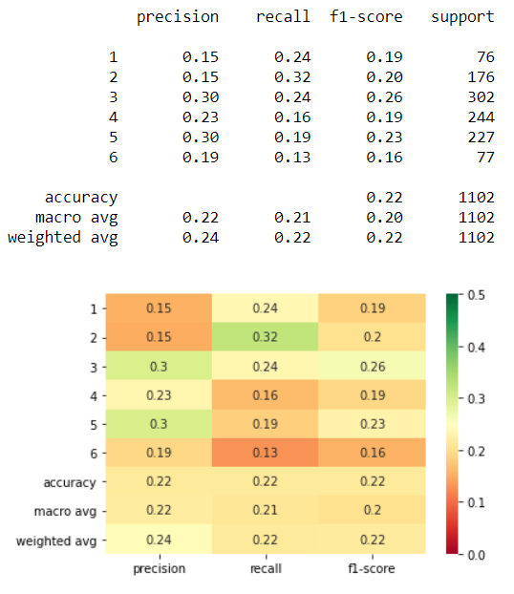
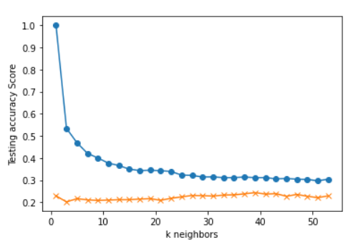

Criteria:
S&P 500 Day(s) Forward Return: 1
Number of Return Percentile Bins: 6
1: Lowest 10% Returns Below -1.30%
2: 10% to 30% Between -1.30% and -0.32%
3: 30% to 50% Between -0.32% and 0.06%
4: 50% to 70% Between 0.06% and 0.46%
5: 70% to 90% Between 0.46% and 1.27%
6: Highest 10% Returns Above 1.27%
X-Feature Inputs: K Neighbors: 39
12WMA%12EMA
12WMA%26EMA
12EMA%26EMA
50SMA%100SMA
50SMA%200SMA
100SMA%200SMA
RSI
SP500 corr 6Mo-3Mo % Ret
Div/10Yr-2Yr
SP500%12WMA
SP500%12EMA
SP500%26EMA
SP500%50SMA
SP500%100SMA
SP500%200SMA
SP500%3Upper
SP500%2Upper
SP500%Middle20Day
SP500%2Lower
SP500%3Lower

Slide 4
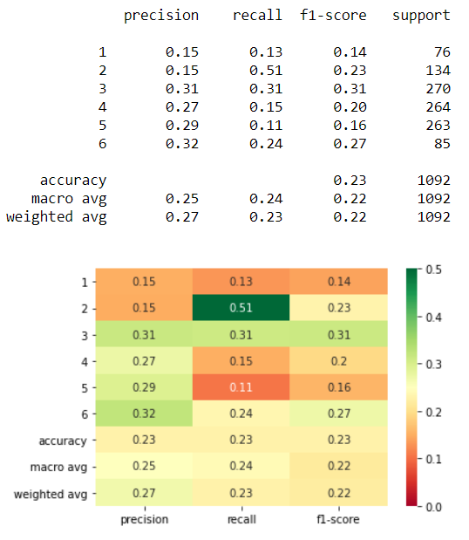
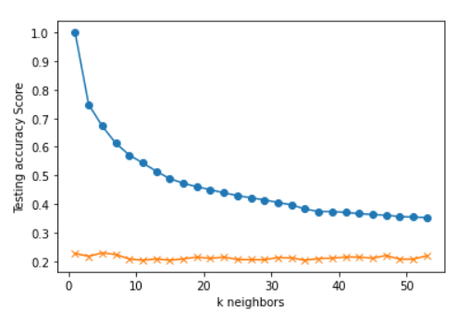
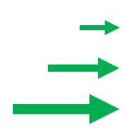
Criteria:
S&P 500 Day(s) Forward Return: 10
Number of Return Percentile Bins: 6
1: Lowest 10% Returns Below -3.69%
2: 10% to 30% Between -3.69% and -0.88%
3: 30% to 50% Between -0.88% and 0.54%
4: 50% to 70% Between 0.54% and 1.73%
5: 70% to 90% Between 1.73% and 3.73%
6: Highest 10% Returns Above 3.73%
X-Feature Inputs: K Neighbors: 5
12WMA%12EMA
12WMA%26EMA
12EMA%26EMA
50SMA%100SMA
50SMA%200SMA
100SMA%200SMA
RSI
SP500 corr 6Mo-3Mo % Ret
Div/10Yr-2Yr
SP500%12WMA
SP500%12EMA
SP500%26EMA
SP500%50SMA
SP500%100SMA
SP500%200SMA
SP500%3Upper
SP500%2Upper
SP500%Middle20Day
SP500%2Lower
SP500%3Lower

Slide 5
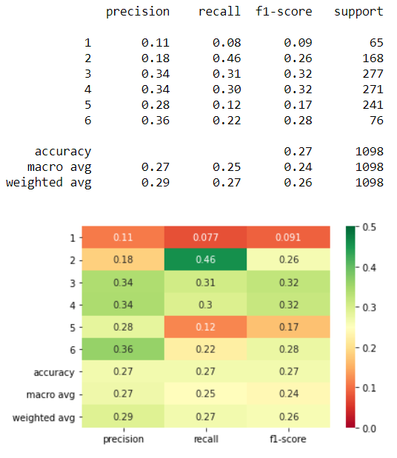
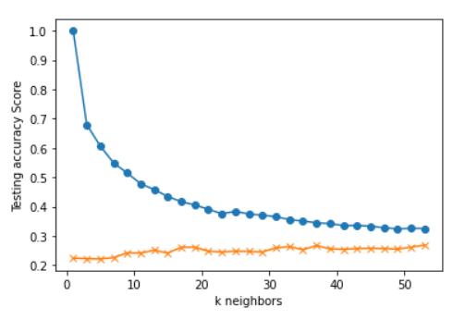
Criteria:
S&P 500 Day(s) Forward Return: 5
Number of Return Percentile Bins: 6
1: Lowest 10% Returns Below -2.78%
2: 10% to 30% Between -2.78% and -0.70%
3: 30% to 50% Between -0.70% and 0.29%
4: 50% to 70% Between 0.29% and 1.19%
5: 70% to 90% Between 1.19% and 2.70%
6: Highest 10% Returns Above 2.70%
X-Feature Inputs: K Neighbors: 37
12WMA%12EMA
12WMA%26EMA
12EMA%26EMA
50SMA%100SMA
50SMA%200SMA
100SMA%200SMA
RSI
SP500 corr 6Mo-3Mo % Ret
Div/10Yr-2Yr
SP500%12WMA
SP500%12EMA
SP500%26EMA
SP500%50SMA
SP500%100SMA
SP500%200SMA
SP500%3Upper
SP500%2Upper
SP500%Middle20Day
SP500%2Lower
SP500%3Lower

Slide 6
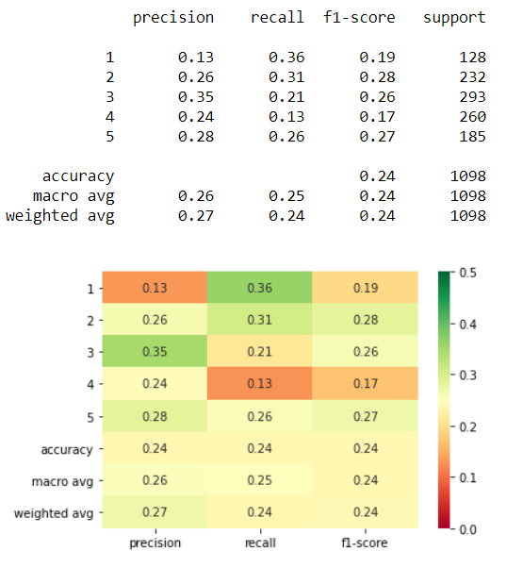
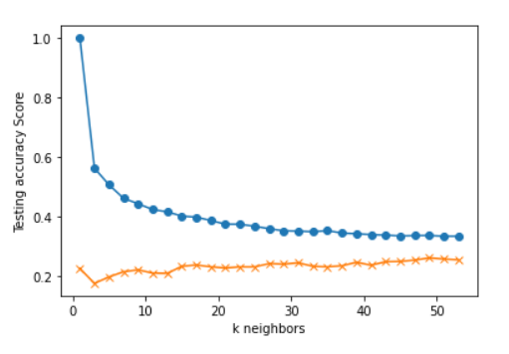
Criteria:
S&P 500 Day(s) Forward Return: 5
Number of Return Percentile Bins: 5
1: Lowest 20% Returns Below -1.47%
2: 20% to 40% Between -1.47% and -0.14%
3: 40% to 60% Between -0.14% and 0.72%
4: 60% to 80% Between 0.72% and 1.74%
5: Highest 20% Returns Above 1.74%
X-Feature Inputs: K Neighbors: 17
12WMA%12EMA
12WMA%26EMA
12EMA%26EMA
50SMA%100SMA
50SMA%200SMA
100SMA%200SMA
RSI
SP500 corr 6Mo-3Mo % Ret
Div/10Yr-2Yr
SP500%12WMA
SP500%12EMA
SP500%26EMA
SP500%50SMA
SP500%100SMA
SP500%200SMA
SP500%3Upper
SP500%2Upper
SP500%Middle20Day
SP500%2Lower
SP500%3Lower

Slide 7
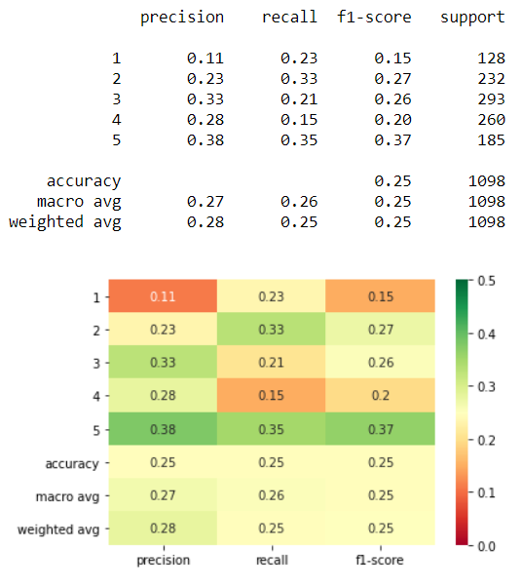
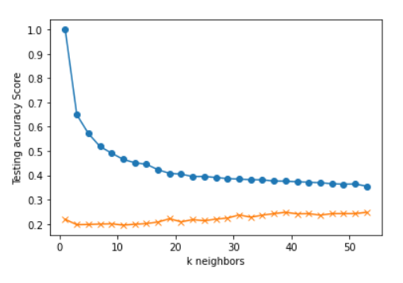
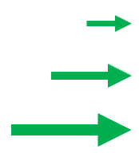
Criteria:
S&P 500 Day(s) Forward Return: 5
Number of Return Percentile Bins: 5
1: Lowest 20% Returns Below -1.47%
2: 20% to 40% Between -1.47% and -0.14%
3: 40% to 60% Between -0.14% and 0.72%
4: 60% to 80% Between 0.72% and 1.74%
5: Highest 20% Returns Above 1.74%
X-Feature Inputs: K Neighbors: 39
12WMA%12EMA
12WMA%26EMA
12EMA%26EMA
50SMA%100SMA
50SMA%200SMA
100SMA%200SMA
RSI
SP500 corr 6Mo-3Mo % Ret
Div/10Yr-2Yr
SP500%12WMA
SP500%12EMA
SP500%26EMA
SP500%50SMA
SP500%100SMA
SP500%200SMA
SP500%3Upper
SP500%2Upper
SP500%Middle20Day
SP500%2Lower
SP500%3Lower

Slide 8
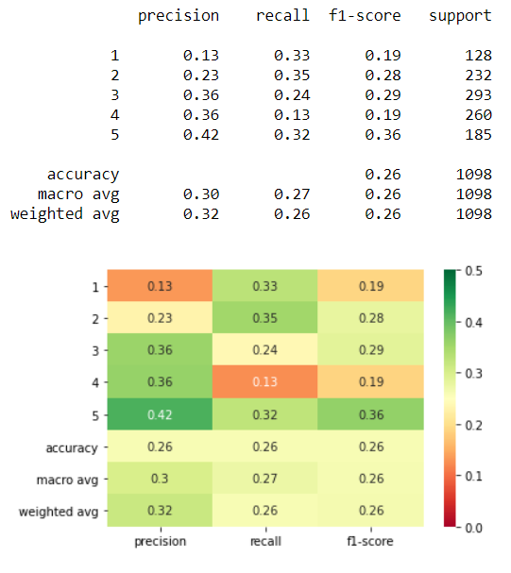
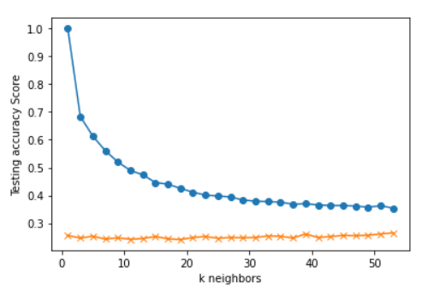
Criteria:
S&P 500 Day(s) Forward Return: 5
Number of Return Percentile Bins: 5
1: Lowest 20% Returns Below -1.47%
2: 20% to 40% Between -1.47% and -0.14%
3: 40% to 60% Between -0.14% and 0.72%
4: 60% to 80% Between 0.72% and 1.74%
5: Highest 20% Returns Above 1.74%
X-Feature Inputs: K Neighbors: 39
12WMA%12EMA
12WMA%26EMA
12EMA%26EMA
50SMA%100SMA
50SMA%200SMA
100SMA%200SMA
RSI
SP500 corr 6Mo-3Mo % Ret
Div/10Yr-2Yr
SP500%12WMA
SP500%12EMA
SP500%26EMA
SP500%50SMA
SP500%100SMA
SP500%200SMA
SP500%3Upper
SP500%2Upper
SP500%Middle20Day
SP500%2Lower
SP500%3Lower

Slide 9
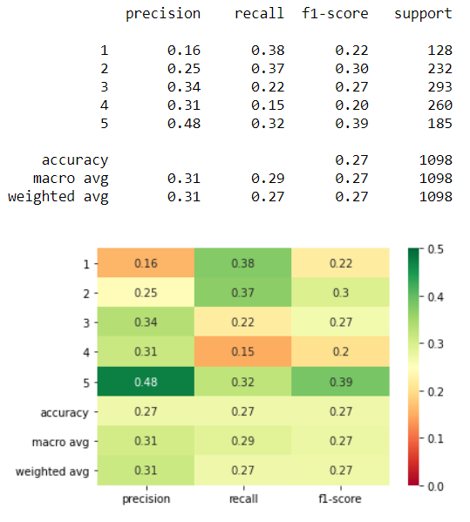
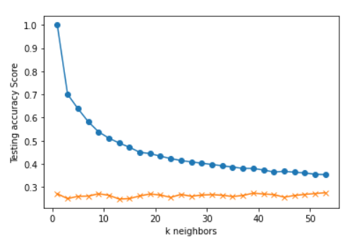
Criteria:
S&P 500 Day(s) Forward Return: 5
Number of Return Percentile Bins: 5
1: Lowest 20% Returns Below -1.47%
2: 20% to 40% Between -1.47% and -0.14%
3: 40% to 60% Between -0.14% and 0.72%
4: 60% to 80% Between 0.72% and 1.74%
5: Highest 20% Returns Above 1.74%
X-Feature Inputs: K Neighbors: 9
12WMA%12EMA
12WMA%26EMA
12EMA%26EMA
50SMA%100SMA
50SMA%200SMA
100SMA%200SMA
RSI
SP500 corr 6Mo-3Mo % Ret
Div/10Yr-2Yr
SP500%12WMA
SP500%12EMA
SP500%26EMA
SP500%50SMA
SP500%100SMA
SP500%200SMA
SP500%3Upper
SP500%2Upper
SP500%Middle20Day
SP500%2Lower
SP500%3Lower

Slide 10
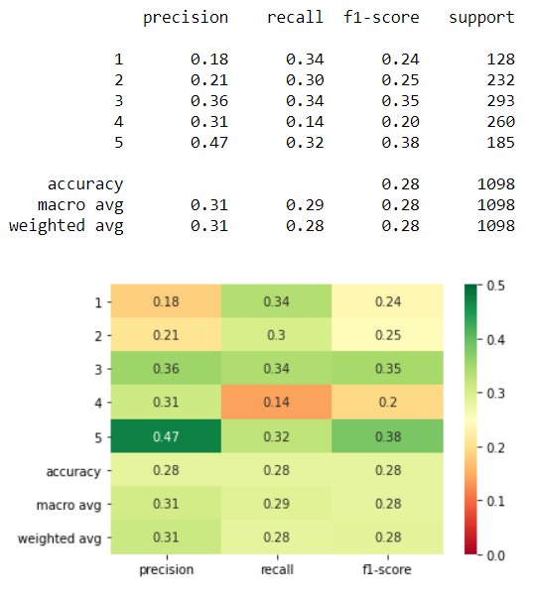
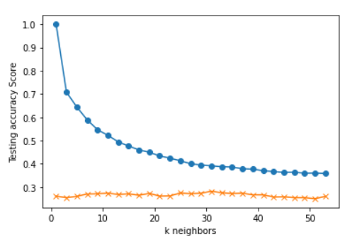
Criteria:
S&P 500 Day(s) Forward Return: 5
Number of Return Percentile Bins: 5
1: Lowest 20% Returns Below -1.47%
2: 20% to 40% Between -1.47% and -0.14%
3: 40% to 60% Between -0.14% and 0.72%
4: 60% to 80% Between 0.72% and 1.74%
5: Highest 20% Returns Above 1.74%
X-Feature Inputs: K Neighbors: 31
12WMA%12EMA
12WMA%26EMA
12EMA%26EMA
50SMA%100SMA
50SMA%200SMA
100SMA%200SMA
RSI
SP500 corr 6Mo-3Mo % Ret
Div/10Yr-2Yr
SP500%12WMA
SP500%12EMA
SP500%26EMA
SP500%50SMA
SP500%100SMA
SP500%200SMA
SP500%3Upper
SP500%2Upper
SP500%Middle20Day
SP500%2Lower
SP500%3Lower

Slide 11
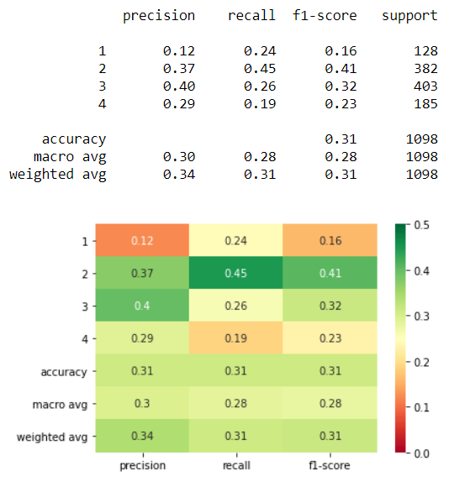
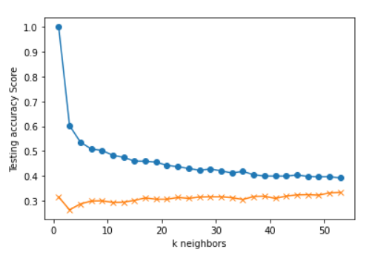
Criteria:
S&P 500 Day(s) Forward Return: 5
Number of Return Percentile Bins: 4
1: Lowest 20% Returns Below -1.47%
2: 20% to 50% Between -1.47% and 0.29%
3: 50% to 80% Between 0.29% and 1.74%
4: Highest 20% Returns Above 1.74%
X-Feature Inputs: K Neighbors: 17
12WMA%12EMA
12WMA%26EMA
12EMA%26EMA
50SMA%100SMA
50SMA%200SMA
100SMA%200SMA
RSI
SP500 corr 6Mo-3Mo % Ret
Div/10Yr-2Yr
SP500%12WMA
SP500%12EMA
SP500%26EMA
SP500%50SMA
SP500%100SMA
SP500%200SMA
SP500%3Upper
SP500%2Upper
SP500%Middle20Day
SP500%2Lower
SP500%3Lower

Slide 12
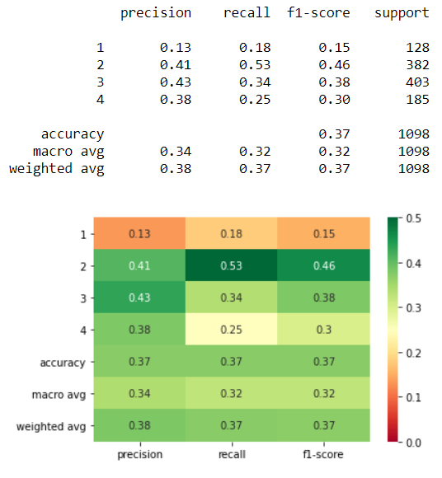
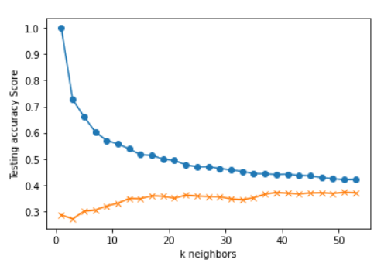

Criteria:
S&P 500 Day(s) Forward Return: 5
Number of Return Percentile Bins: 4
1: Lowest 20% Returns Below -1.47%
2: 20% to 50% Between -1.47% and 0.29%
3: 50% to 80% Between 0.29% and 1.74%
4: Highest 20% Returns Above 1.74%
X-Feature Inputs: K Neighbors: 39
12WMA%12EMA
12WMA%26EMA
12EMA%26EMA
50SMA%100SMA
50SMA%200SMA
100SMA%200SMA
RSI
SP500 corr 6Mo-3Mo % Ret
Div/10Yr-2Yr
SP500%12WMA
SP500%12EMA
SP500%26EMA
SP500%50SMA
SP500%100SMA
SP500%200SMA
SP500%3Upper
SP500%2Upper
SP500%Middle20Day
SP500%2Lower
SP500%3Lower

Slide 13
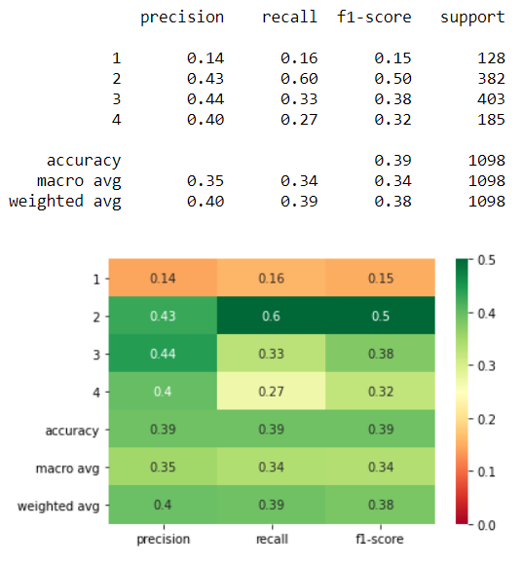
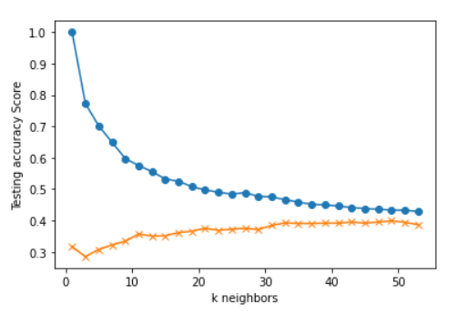
Criteria:
S&P 500 Day(s) Forward Return: 5
Number of Return Percentile Bins: 4
1: Lowest 20% Returns Below -1.47%
2: 20% to 50% Between -1.47% and 0.29%
3: 50% to 80% Between 0.29% and 1.74%
4: Highest 20% Returns Above 1.74%
X-Feature Inputs: K Neighbors: 33
12WMA%12EMA
12WMA%26EMA
12EMA%26EMA
50SMA%100SMA
50SMA%200SMA
100SMA%200SMA
RSI
SP500 corr 6Mo-3Mo % Ret
Div/10Yr-2Yr
SP500%12WMA
SP500%12EMA
SP500%26EMA
SP500%50SMA
SP500%100SMA
SP500%200SMA
SP500%3Upper
SP500%2Upper
SP500%Middle20Day
SP500%2Lower
SP500%3Lower

Slide 14
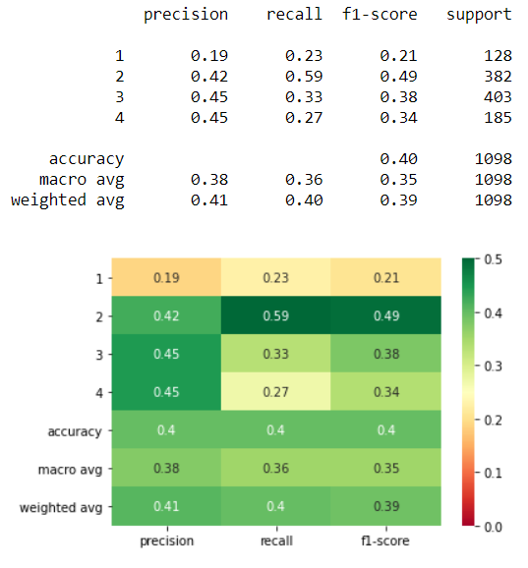
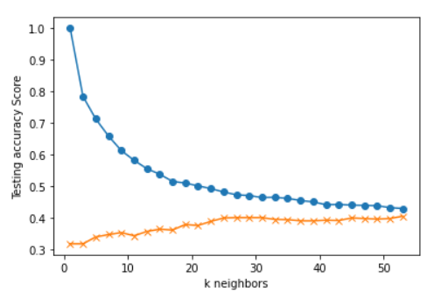
Criteria:
S&P 500 Day(s) Forward Return: 5
Number of Return Percentile Bins: 4
1: Lowest 20% Returns Below -1.47%
2: 20% to 50% Between -1.47% and 0.29%
3: 50% to 80% Between 0.29% and 1.74%
4: Highest 20% Returns Above 1.74%
X-Feature Inputs: K Neighbors: 27
12WMA%12EMA
12WMA%26EMA
12EMA%26EMA
50SMA%100SMA
50SMA%200SMA
100SMA%200SMA
RSI
SP500 corr 6Mo-3Mo % Ret
Div/10Yr-2Yr
SP500%12WMA
SP500%12EMA
SP500%26EMA
SP500%50SMA
SP500%100SMA
SP500%200SMA
SP500%3Upper
SP500%2Upper
SP500%Middle20Day
SP500%2Lower
SP500%3Lower

Slide 15
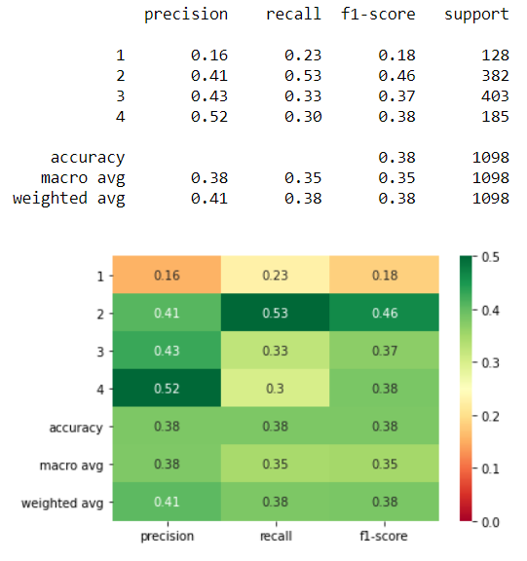
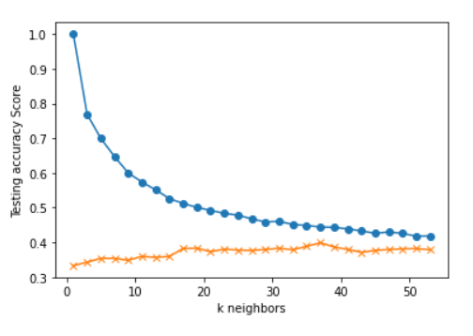
Criteria:
S&P 500 Day(s) Forward Return: 5
Number of Return Percentile Bins: 4
1: Lowest 20% Returns Below -1.47%
2: 20% to 50% Between -1.47% and 0.29%
3: 50% to 80% Between 0.29% and 1.74%
4: Highest 20% Returns Above 1.74%
X-Feature Inputs: K Neighbors: 37
12WMA%12EMA
12WMA%26EMA
12EMA%26EMA
50SMA%100SMA
50SMA%200SMA
100SMA%200SMA
RSI
SP500 corr 6Mo-3Mo % Ret
Div/10Yr-2Yr
SP500%12WMA
SP500%12EMA
SP500%26EMA
SP500%50SMA
SP500%100SMA
SP500%200SMA
SP500%3Upper
SP500%2Upper
SP500%Middle20Day
SP500%2Lower
SP500%3Lower

Slide 16
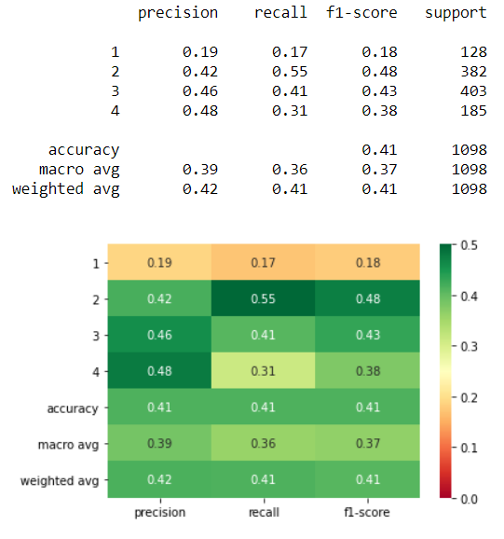
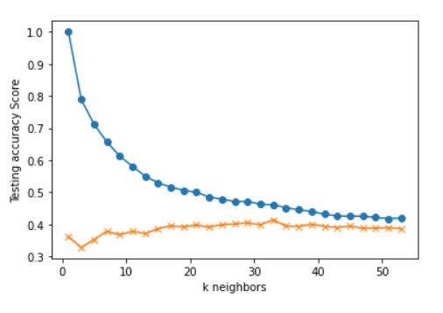
Criteria:
S&P 500 Day(s) Forward Return: 5
Number of Return Percentile Bins: 4
1: Lowest 20% Returns Below -1.47%
2: 20% to 50% Between -1.47% and 0.29%
3: 50% to 80% Between 0.29% and 1.74%
4: Highest 20% Returns Above 1.74%
X-Feature Inputs: K Neighbors: 33
12WMA%12EMA
12WMA%26EMA
12EMA%26EMA
50SMA%100SMA
50SMA%200SMA
100SMA%200SMA
RSI
SP500 corr 6Mo-3Mo % Ret
Div/10Yr-2Yr
SP500%12WMA
SP500%12EMA
SP500%26EMA
SP500%50SMA
SP500%100SMA
SP500%200SMA
SP500%3Upper
SP500%2Upper
SP500%Middle20Day
SP500%2Lower
SP500%3Lower

Slide 17
What Does This All Mean?
We want the highest precision possible in order of importance from bin 4 to 1
The top 17% (185/1098) of the S&P 500’s returns are represented by bin 4
When the model predicts an outcome of 4, there is a 48% chance of being correct
These findings are meaningful because there is a better chance than random at correctly predicting when to place a bet while seeking a top ranked return
This model should be used in conjunction with
other metrics while making investment buy
decisions in order to increase likeliness of
greater percent return
Criteria:
S&P 500 Day(s) Forward Return: 5
Number of Return Percentile Bins: 4
1: Lowest 20% Returns Below -1.47%
2: 20% to 50% Between -1.47% and 0.29%
3: 50% to 80% Between 0.29% and 1.74%
4: Highest 20% Returns Above 1.74%

Slide 18
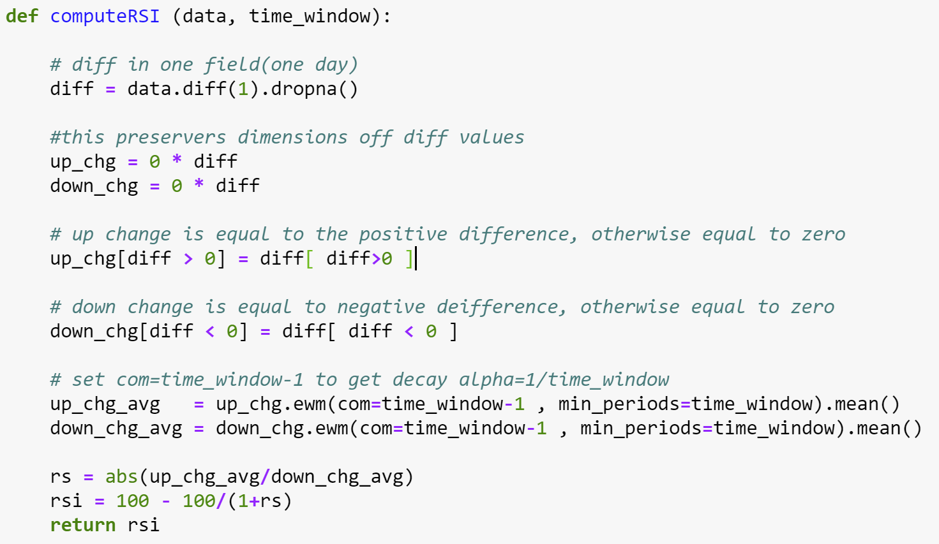
Appendix
RSI (Relative Strength Index):
SP500 corr 6Mo-3Mo % Ret: Correlation between the daily return of the S&P 500 and the daily return of the 6-Month 3-Month spread
Div/10Yr-2Yr: The S&P 500’s dividend yield divided by the spread between the 10-Year and 2-Year US Treasury rate
12WMA%12EMA: Percent change between the S&P 500’s 12-Day Weighted Moving Average and the S&P 500’s 12-Day Exponential Moving Average
12WMA%26EMA: Percent change between the S&P 500’s 12-Day Weighted Moving Average and the S&P 500’s 26-Day Exponential Moving Average

Slide 19
Appendix
12EMA%26EMA: Percent change between the S&P 500’s 12-Day Exponential Moving Average and the S&P 500’s 26-Day Exponential Moving Average
50SMA%100SMA: Percent change between the S&P 500’s 50-Day Simple Moving Average and the S&P 500’s 100-Day Simple Moving Average
50SMA%200SMA: Percent change between the S&P 500’s 50-Day Simple Moving Average and the S&P 500’s 200-Day Simple Moving Average
100SMA%200SMA: Percent change between the S&P 500’s 100-Day Simple Moving Average and the S&P 500’s 200-Day Simple Moving Average
SP500%12WMA: Percent change between the S&P 500 and the S&P 500’s 12-Day Weighted Moving Average
SP500%12EMA: Percent change between the S&P 500 and the S&P 500’s 12-Day Exponential Moving Average
SP500%26EMA: Percent change between the S&P 500 and the S&P 500’s 26-Day Exponential Moving Average
SP500%50SMA: Percent change between the S&P 500 and the S&P 500’s 50-Day Simple Moving Average
SP500%100SMA: Percent change between the S&P 500 and the S&P 500’s 100-Day Simple Moving Average
SP500%200SMA: Percent change between the S&P 500 and the S&P 500’s 200-Day Simple Moving Average

Slide 20
Appendix
SP500%3Upper: Percent change between the S&P 500 and the S&P 500’s Upper, Third Standard Deviation
SP500%2Upper: Percent change between the S&P 500 and the S&P 500’s Upper, Second Standard Deviation
SP500%Middle20Day: Percent change between the S&P 500 and the S&P 500’s 20-Day Simple Moving Average
SP500%2Lower: Percent change between the S&P 500 and the S&P 500’s Lower, Second Standard Deviation
SP500%3Lower: Percent change between the S&P 500 and the S&P 500’s Lower, Third Standard Deviation

Slide 21
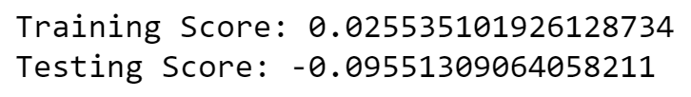
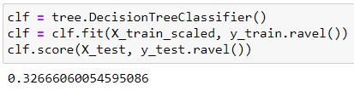
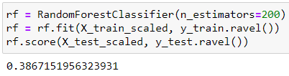
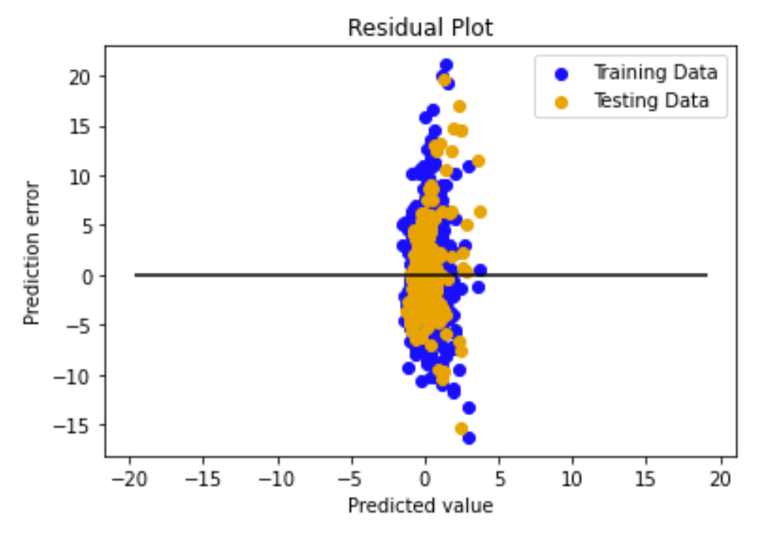
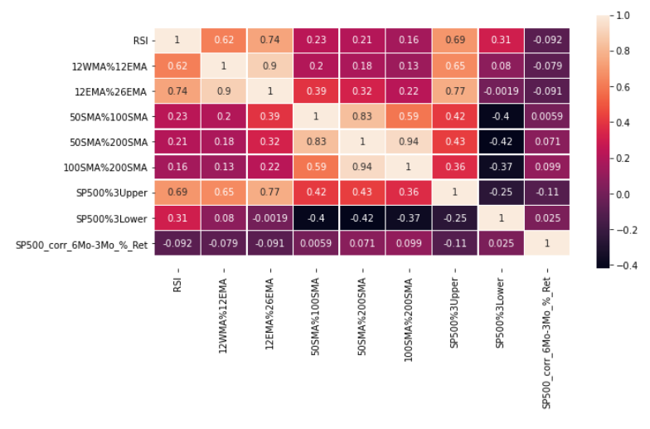
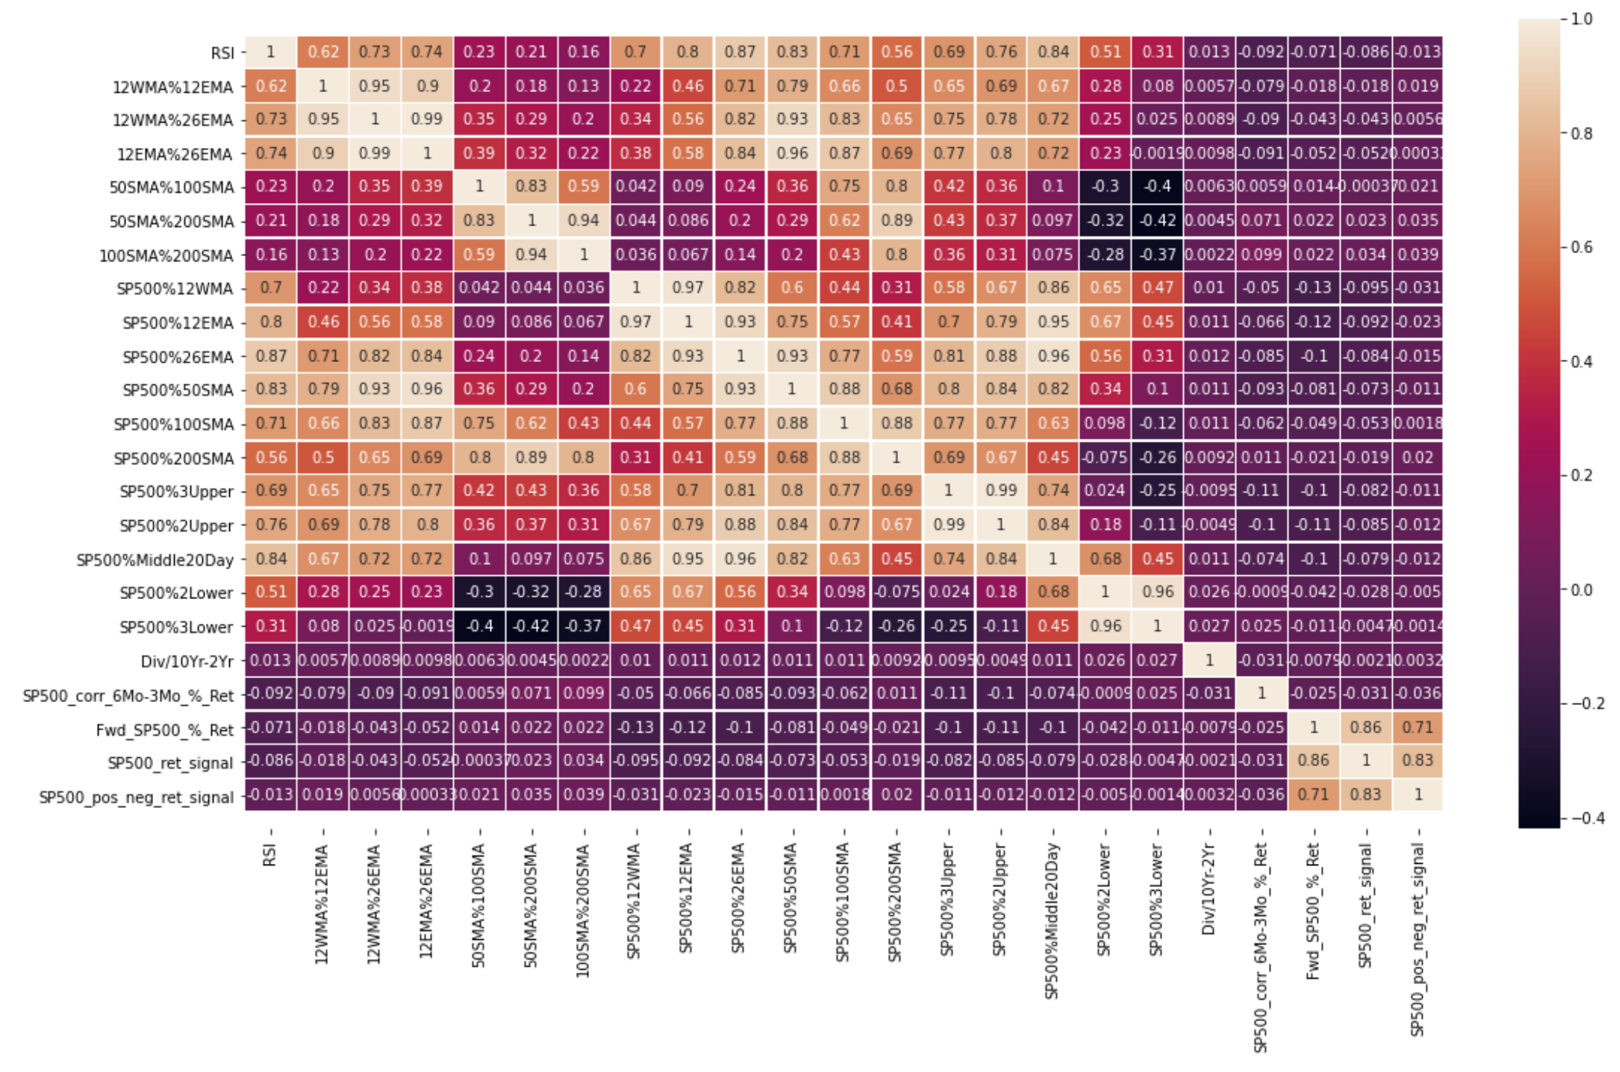
Started with a Regression problem …
Multi-Linear Regression
Random Forest
Feature Correlation Matrix
… having undesirable results …

Slide 22
… and ended with a Classification problem through Discretization …
Feature Correlation Matrix
Classification Report Heatmap
K Neighbors: 37
… having favorable results!

